Slide 1
CANDEV Challenge Dynamic Data Visualization for CRA Open Data
Submitted By:
Jobanpreet Kaur
Gobindbir Singh
Milan Vashisht
Itah Kozlov

Slide 2
Objective:
The objective of this project is to use the Open Data provided by the CRA to get meaningful insights from the data.
The data used in this project has be fetched from https://www.canada.ca/en/revenue-agency/programs/about-canada-revenue-agency-cra/income-statistics-gst-hst-statistics.html
The scope has been kept limited to give the user insights into the number of tax filers and the number of tax returns based on different independent variables.

Slide 3
Process Followed:
The relevant datasets for the insights were downloaded and analyzed to to find some meaningful information for the user.
Python scripts were used to preprocess the data which involved merging of csv files and populating columns for each province data.
More preprocessing was done to bring data into a same format across different years as some years had missing columns.
After the processed data was achieved, Tableau solution was developed to achieve insights from rich visualizations.

Slide 4
User Experience
In order to enrich the user experience and provide the user with dynamic selection of data, we limited our visualizations to Bar Graphs, Maps and Line Graph Trends.
The intent is to show maximum dynamic information to the user through the simplest visualizations which are easy to understand.

Slide 5
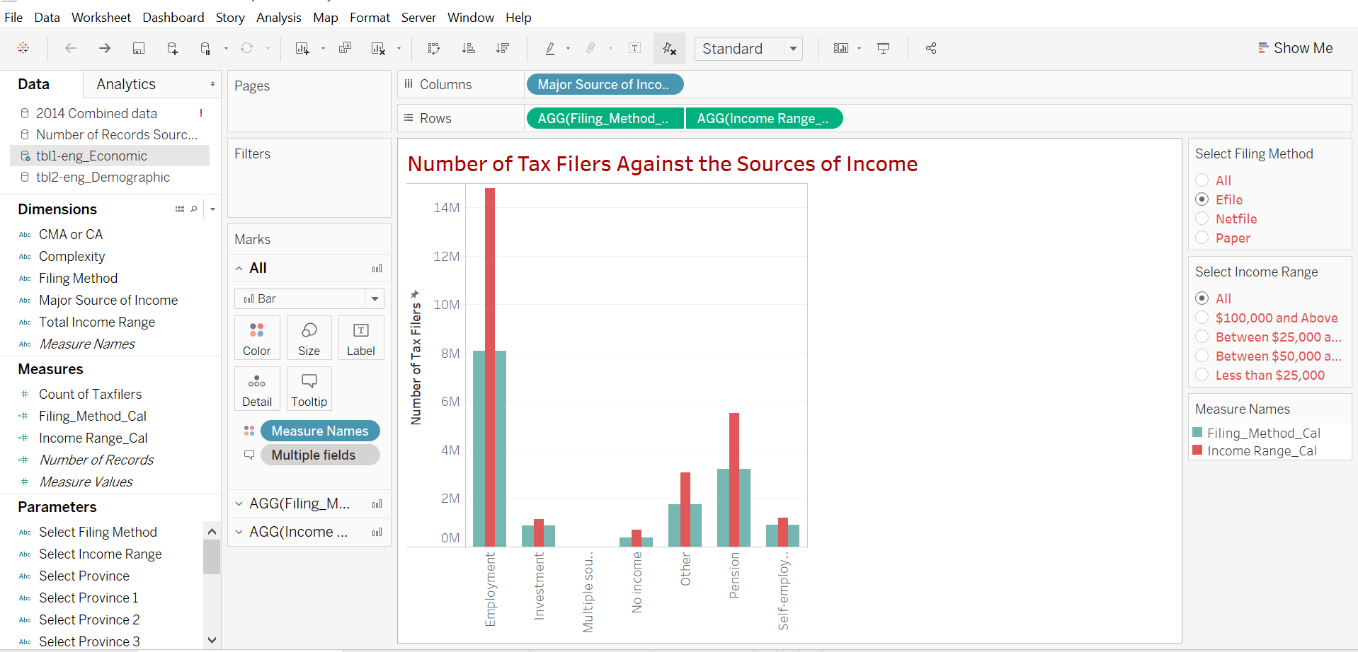
Tableau Visualizations

Slide 6
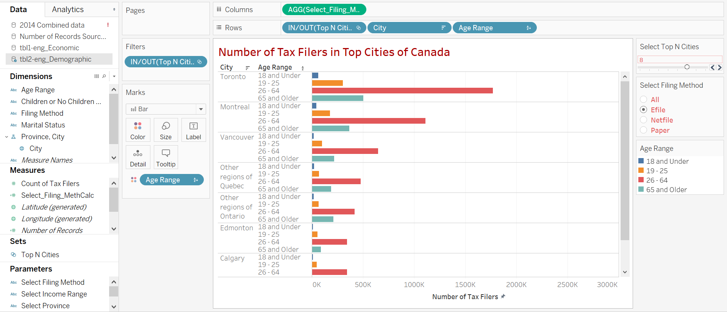

Slide 7
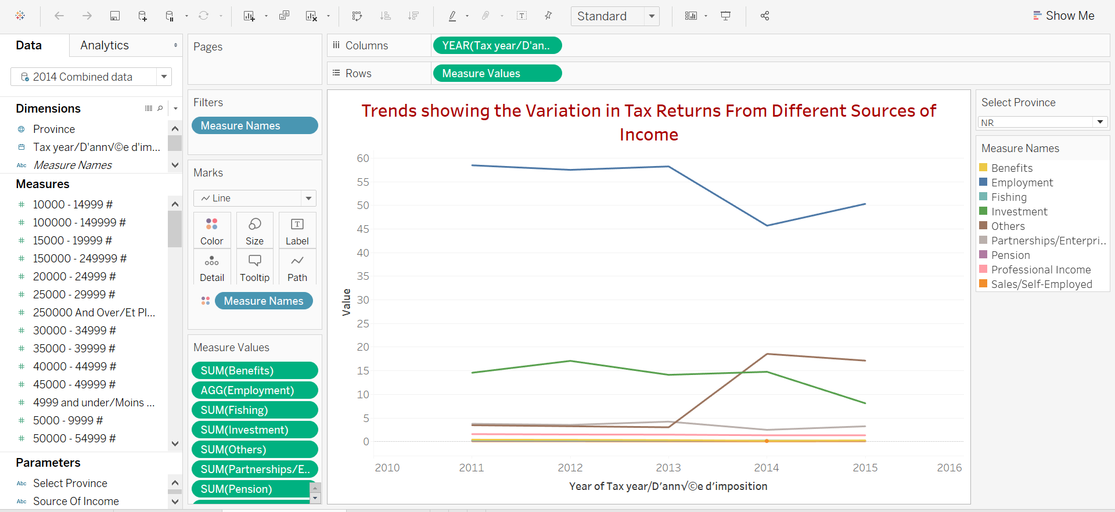

Slide 8
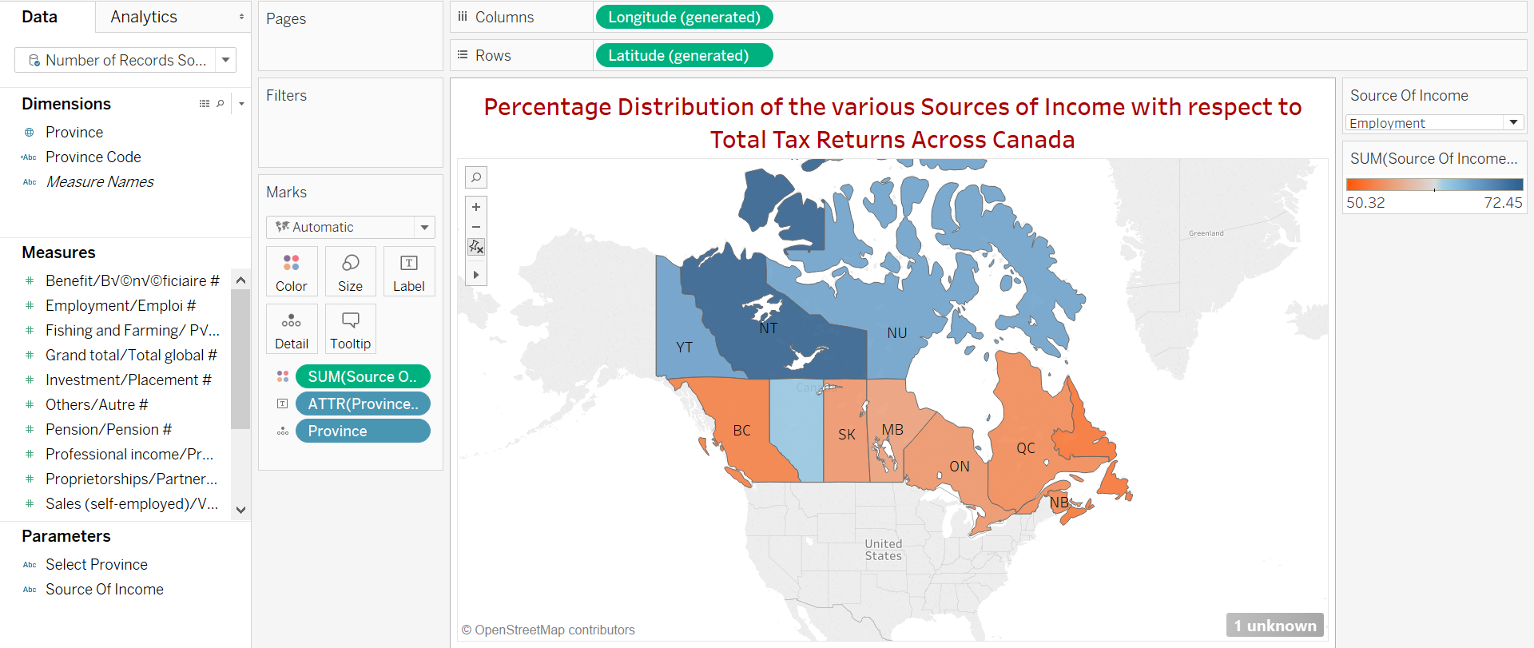

Slide 9
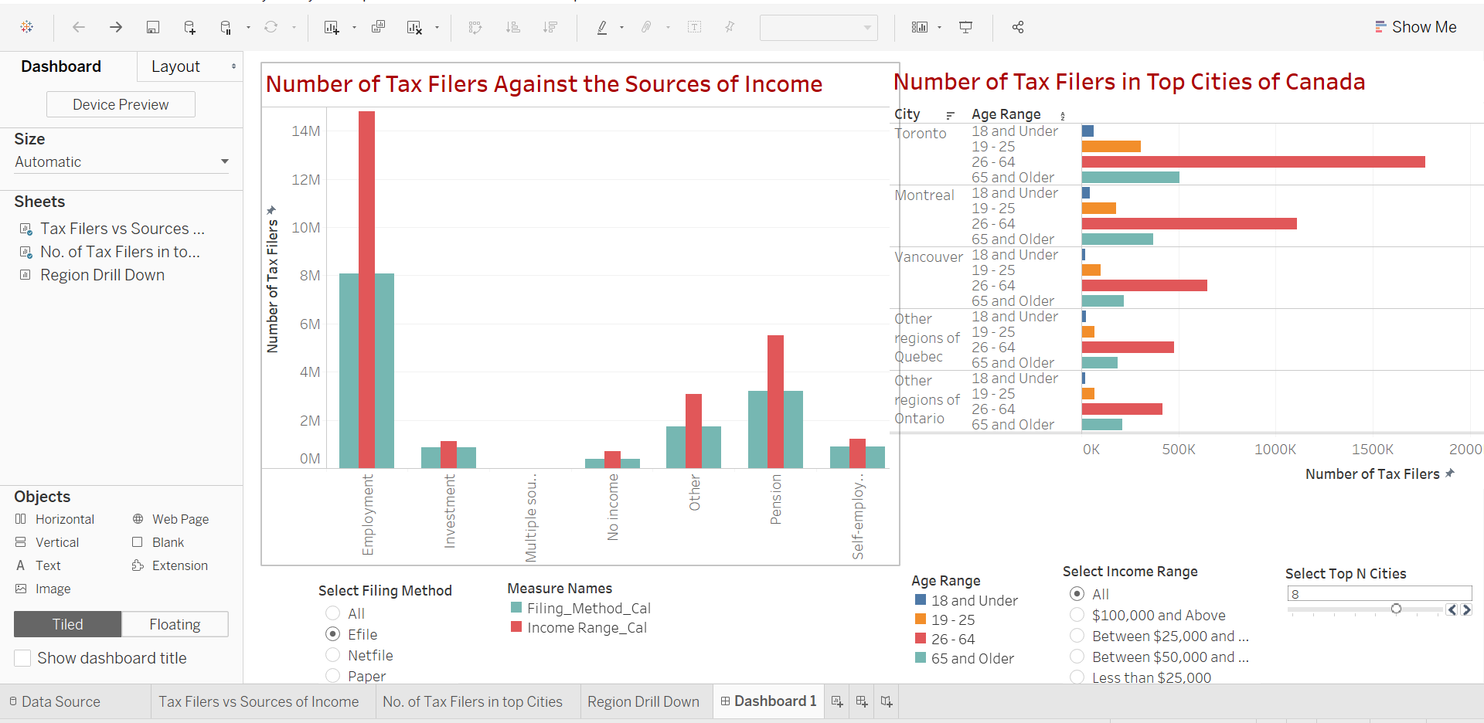
Tableau Dashboards

Slide 10
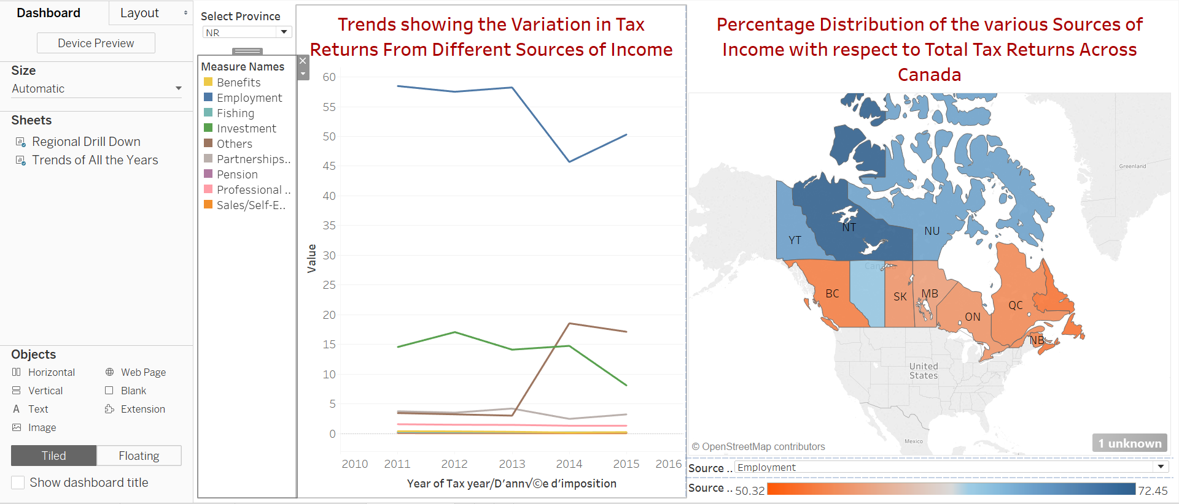

Slide 11
THANKYOU
Any Questions are welcome

